Slide 1

HTML
Charles Severance
www.dj4e.com
https://www.dj4e.com/code/html.zip
Notes:
Note from Chuck. If you are using these materials, you can remove my name and URL from this replace it with your own, but please retain the CC-BY logo on the first page as well as retain the entire last page when you remix and republish these slides.
TO Highlight – go to https://tohtml.com/html/ - paste and then do a "Paste RTF"

Slide 2


Time
Browser
Web Server
Database Server
DOM
Django
static
files
Sqlite or PostgreSQL
Parse
Request
Parse
Response
Views
django
code
JavaScript
RRC/HTTP
SQL

Slide 3

HTML
A way of marking up text to indicate that some text is different than other text
We “tag” portions of the text to communicate meaning
<p>You can add a style like <strong>bold</strong> to some text by enclosing it in the <em>appropriate</em> tag.</p>

Slide 4
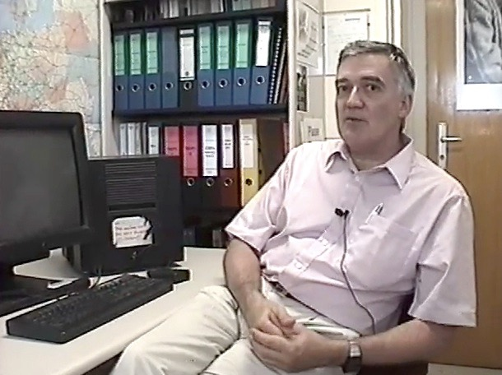
The Web is Still Evolving
Invented in early 1990s
Became popular in 1994
Robert Cailliau – co-founder of the World Wide Web
https://www.youtube.com/watch?v=x2GylLq59rI

Slide 5
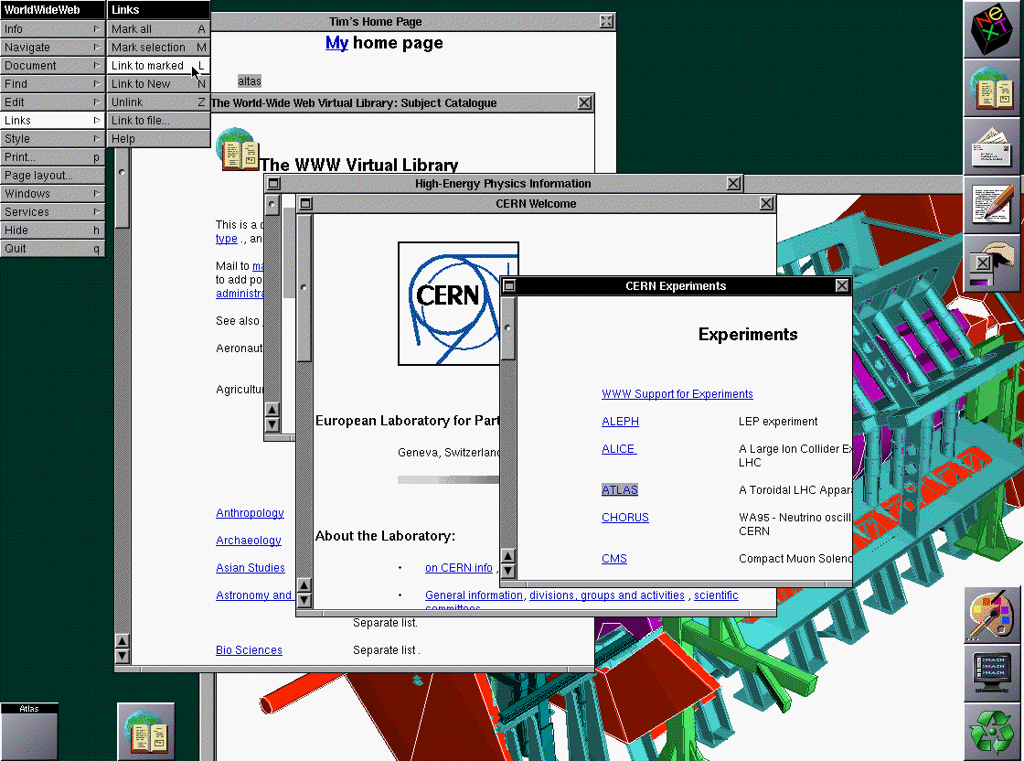
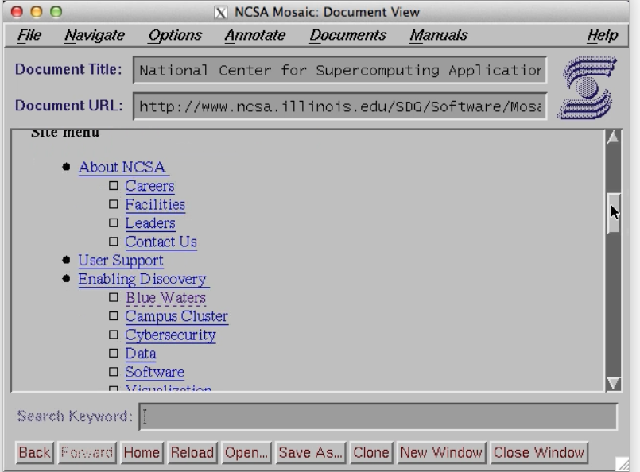
http://www.w3.org/History/1994/WWW/Journals/CACM/screensnap2_24c.gif

Slide 6
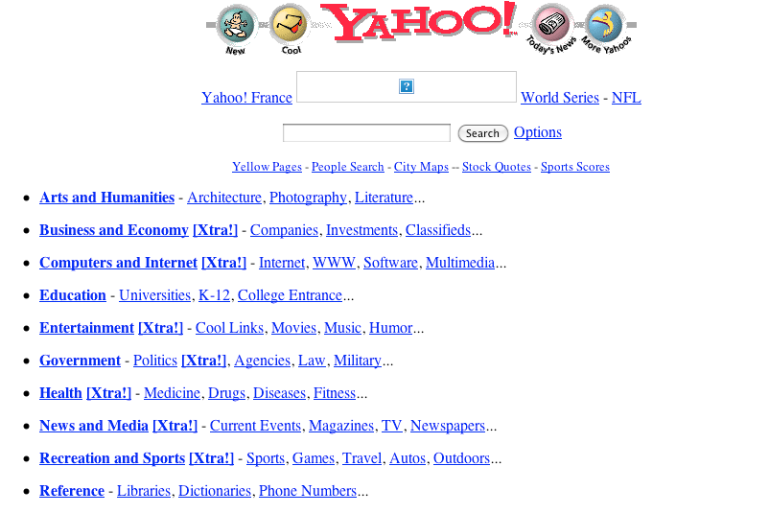
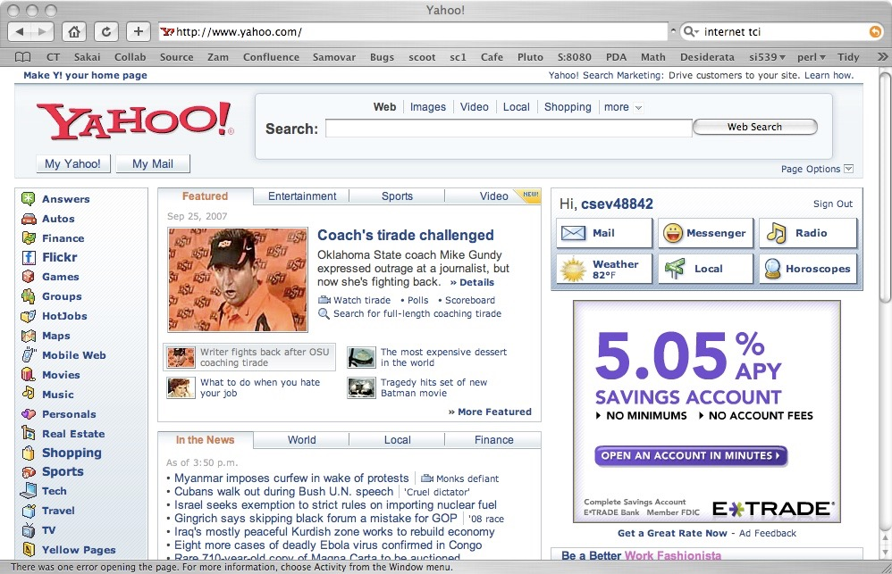
HTML has evolved a *lot* over the years - as computers and networks have gotten faster
1996
2007
http://replay.waybackmachine.org/19961022175643/http://www10.yahoo.com/

Slide 7
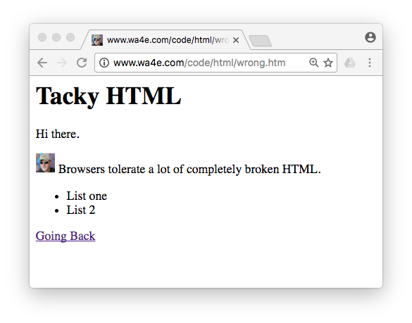
The Good Old Days
<H1>Tacky HTML</H1>
Hi there.
<p><img src=tiny.png>
Browsers tolerate a lot of
completely broken HTML.
<UL>
<LI>List one
<LI>List 2
</UL>

Slide 8

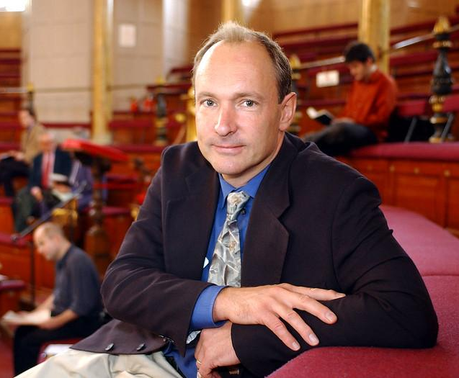
World Wide Web Consortium
Formed by Tim Berners-Lee of MIT (formerly of CERN)
Founded to develop standards around HTML, CSS, XML, etc.
Insure that the web was based on open standards rather than proprietary vendor products - a bit like cat herding
Sir Tim Berners Lee by Knight Foundation licensed under CC BY-SA 2.0
http://www.w3.org/Consortium/facts

Slide 9
Following the Rules
<h1>Tacky HTML</h1>
Hi there.
<p><img src="tiny.png">
Browsers tolerate a lot of
completely broken HTML.
</p>
<ul>
<li>List one</li>
<li>List 2</li>
</ul>
Tags must be lowercase.
Attributes must be enclosed in quotes.
Tags must be closed.

Slide 10
HTML Documents

Slide 11
Structure of an HTML Document
<!DOCTYPE html>
<html>
<head>
metadata....
</head>
<body>
Page content....
</body>
</html>
Metadata about the page
Displayable content of the page

Slide 12
Special File Names
When a URL points to a directory in your web server, it looks for a file with a special name:
index.html, index.htm, index.php, etc.
While there is a convention, the “default file” is configurable.
Usually index.htm or index.html is a safe bet.
This only works when viewing through a web server - when viewing from disk, you must view the file.

Slide 13
Multiple Files
We can put multiple files in the same directory and then use them in relative links.
csev$ ls -l
-rw-r--r-- 1 csev staff 618 Dec 18 22:56 index.htm
-rw-r--r-- 1 csev staff 883 Dec 18 22:57 images.htm
-rw-r--r-- 1 csev staff 679 Dec 18 22:57 tables.htm
-rw-r--r-- 1 csev staff 5909 Dec 18 22:57 tiny.png
csev$

Slide 14
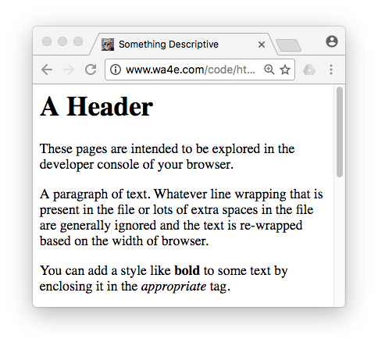
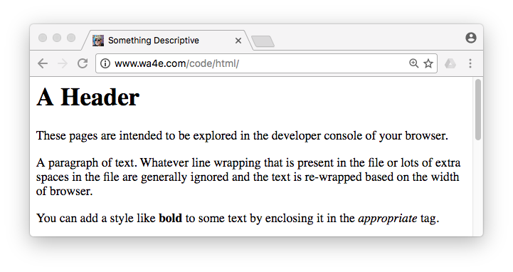
<p>You can add a style like <strong>bold</strong> to some text by enclosing it in the <em>appropriate</em> tag.</p>
Whitespace and line wrapping

Slide 15
Tags Have a Beginning and /End...
<p>You can add a style like <strong>bold</strong> to some text by enclosing it in the <em>appropriate</em> tag.</p>

Slide 16
HTML Tag Basics
Start tag
End tag
Tags “mark up” the HTML document. The tags are read and interpreted by the browser but not shown.
<h1>Hello World</h1>
Attribute
<img src="x.png" />
A self-closing tag does not need a corresponding end tag.
Self-closing tag

Slide 17
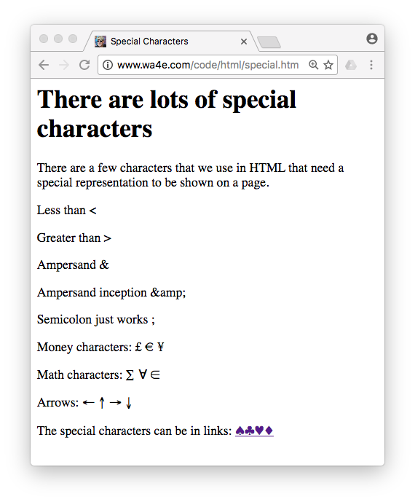
What about < s ?
<p>Less than &lt;</p>
<p>Greater than &gt;</p>
<p>Ampersand &amp;</p>
<p>Ampersand inception &amp;amp;</p>
<p>Semicolon just works ;</p>
<p>Money characters: &pound; &euro; &yen;</p>
<p>Math characters: &sum; &forall; &isin;</p>
<p>Arrows: &larr; &uarr; &rarr; &darr;</p>
<p>The special characters can be
in links: <a href="lists.htm">
&spades;&clubs;&hearts;&diams;</a></p>

Slide 18
HTML Comments
<!-- Ignore this for now :) -->
<p style="border-style: none; position:fixed;
bottom: 10px; right: 10px;">Go to the
<a href="navdetail.htm">very last page</a>.</p>

Slide 19
HTML Links
One of the key things about HTML is making a set of pages and creating “hypertext” links amongst those pages.
Links are what make the “web” into a web of interlinked documents.
The interlinked nature of the web leads to the “intelligence” that search engines like Google appear to have.

Slide 20
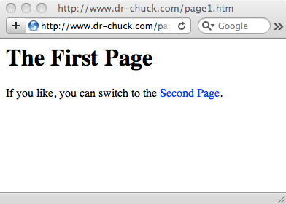
<h1>The First Page</h1>
<p>
If you like, you can switch to the
<a href="http://www.dr-chuck.com/page2.htm">
Second Page</a>.
</p>
A link is a “hot spot” on the page. It can be text or an image. Often it is visually marked to make it easier to “notice” so as to encourage users to click!
“a” is short for “anchor” and “href” is short for “hypertext reference”

Slide 21
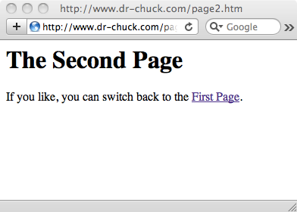
<h1>The Second Page</h1>
<p>
If you like, you can switch back to the
<a href="page1.htm">
First Page</a>.
</p>

Slide 22
Absolute Reference
<a href="http://www.dr-chuck.com/page2.htm">Second Page</a>
End
tag
Start
tag
Where to
go if clicked
Clickable
Text
<a href="page1.htm">First Page</a>
Relative Reference

Slide 23
Absolute vs. Relative
<a href="http://www.dr-chuck.com/page2.htm">Second Page</a>
A hypertext references can be a full URL and refer to some other page anywhere on the Internet.
<a href="page1.htm">First Page</a>
Or the reference can be a file name that is assumed to be in the same folder as the current document (relative reference).

Slide 24
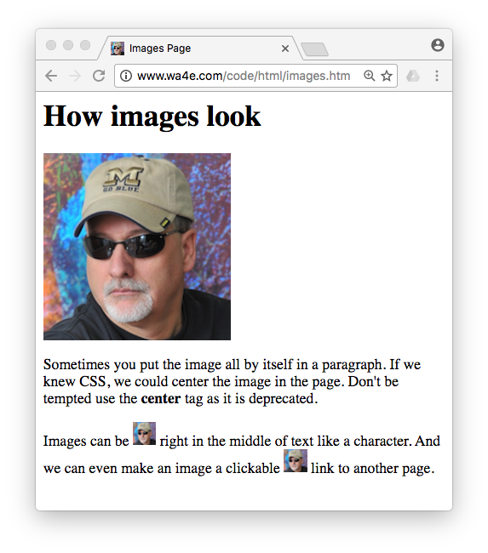
Images
<p>
Images can be <img src="tiny.png"> right in the middle of text like a character. And we can even make an image a clickable
<a href="lists.htm"><img src="tiny.png"></a> link to another page.
</p>
Begin Tag
Begin Tag

Slide 25
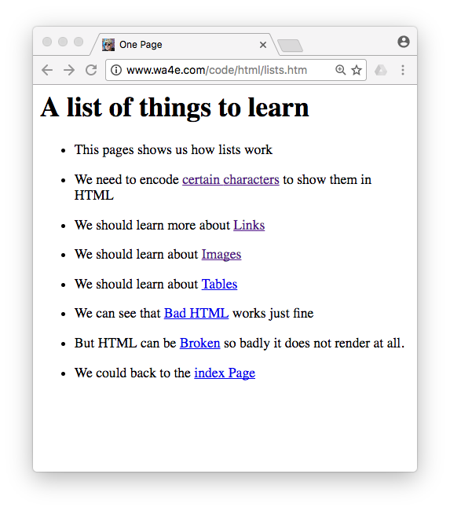
A List ...
<ul>
<li><p>This pages shows us how
lists work</p></li>
<li><p>We need to encode
<a href="special.htm">certain
characters</a>
to show them in HTML</p></li>
<li><p>We should learn more about
<a href="links.htm">Links</a>
</p></li>
<li><p>We should learn about
<a href="images.htm">Images</a>
</p></li>
</ul>

Slide 26
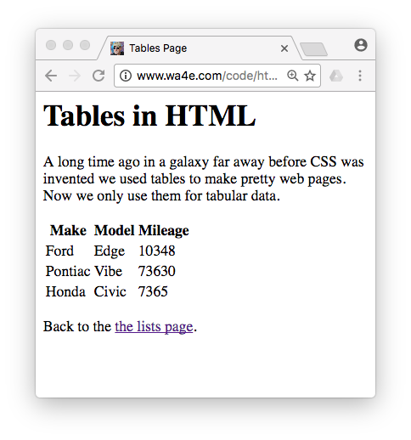
Tables
<table>
<tr>
<th>Make</th>
<th>Model</th>
<th>Mileage</th>
</tr>
<tr>
<td>Ford</td><td>Edge</td>
<td>10348</td>
</tr>
<tr>
<td>Pontiac</td><td>Vibe</td><td>73630</td>
</tr>
</table>

Slide 27
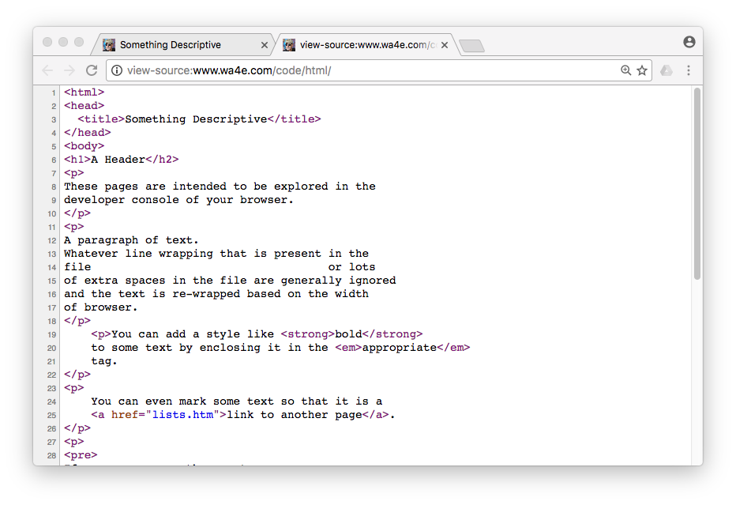
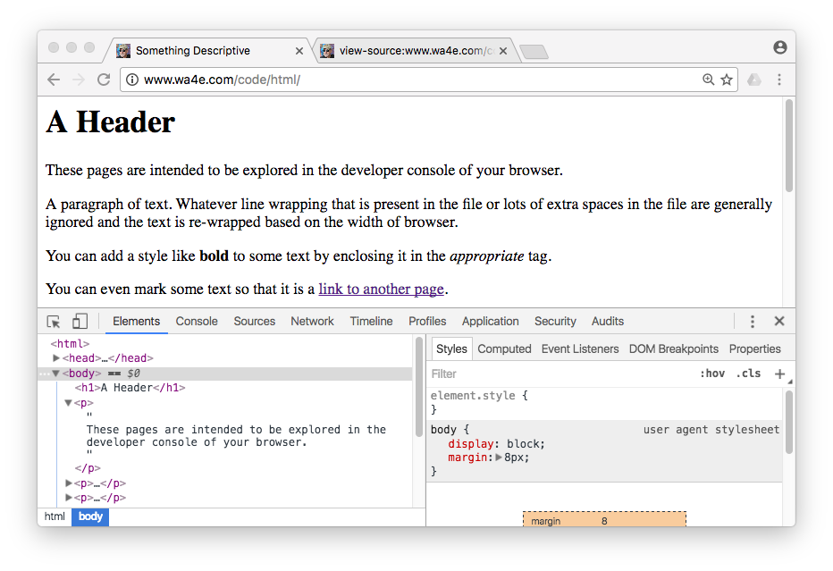
Explore Sample Code

Slide 28
Explore Sample Code

Slide 29
Summary
HTML has gone through many changes and evolutions.
It started clean and simple - then got ugly and nasty - now we are back to a clean and simple approach.
A key to modern/clean HTML is that formatting is handled using CSS - Cascading Style Sheets.

Slide 30
Acknowledgements / Contributions
These slides are Copyright 2010- Charles R. Severance (www.dr-chuck.com) as part of www.dj4e.com and made available under a Creative Commons Attribution 4.0 License. Please maintain this last slide in all copies of the document to comply with the attribution requirements of the license. If you make a change, feel free to add your name and organization to the list of contributors on this page as you republish the materials.
Initial Development: Charles Severance, University of Michigan School of Information
Insert new Contributors and Translators here including names and dates
Continue new Contributors and Translators here

